Slide 1

Modern C++元编程应用
祁 宇
qicosmos@163.com
purecpp.org

Slide 2


静态检查
探测
编译期计算
反射
从编译期到运行期
从运行期到编译期
消除重复(宏)
泛化与统一
易用和灵活
使用元编程

Slide 4
安全检查
探测
计算
反射

Slide 5
Introduction

Slide 6
Introduction
Usage example: C++ ↔ Java Bridge
class InputStream // java.io.InputStream
{
public:
inline void close() { jclass.getMethod("close").invoke(); }
inline long skip(long bytes) { return jclass.getMethod("skip").invoke(bytes); }
inline int read() { return jclass.getMethod("read").invoke(); }
.
.
.
};
called in tight-loop
Ensure getMethod is as fast as possible
Auto-generated C++ code for every Java class
Notes:
Put comments in code

Slide 7
Introduction
Use a cache!
JavaMethod getMethod(const std::string& methodName)
{
static std::unordered_map<std::string, JavaMethod> cache;
return cache.try_emplace(methodName, methodName).first->second;
}
try_emplace needs to calculate the hash of methodName
Collisions expected as thousands of methods in cache
Can we do better?

Slide 8
Introduction
Use a cache!
class InputStream // java.io.InputStream
{
public:
void close() { jclass.getMethod("close").invoke(); }
long skip(long bytes) { return jclass.getMethod("skip").invoke(bytes); }
int read() { return jclass.getMethod("read").invoke(); }
};
String literals
methodName is known at compile-time
it should be possible to calculate the cache slot at compile-time
Fallback to run-time hash if methodName is not a string literal
Somebody must have done this already, right?
Notes:
Add life-time management to requirements

Slide 9
Introduction
Ben Deane’s and Jason Turner’s “constepxr all the things”^{1,2}
cx::map<Key, Value>
map is either completely compile-time or completely run-time
If lookup is compile-time then all values must also be known at compile-time
JavaMethod can only be resolved at run-time
✘ Compile-time lookup of run-time value not possible
¹https://www.youtube.com/watch?v=PJwd4JLYJJY
²there are many more compile-time only maps (for example boost::hana::map)

Slide 10
Introduction
Louis Dionne’s C++ meta-programming talk at meeting C++¹
event_system events{{"foo", "bar", "baz"}}
✔ Lookup at compile-time and value-storage at runtime
✔ Can fallback to run-time lookup if key is not string literal
✘ Need to know all possible keys in advance
¹https://goo.gl/M4vhqc from slide 73 onwards

Slide 11
Introduction
Let’s roll our own!
semi::map<Key, Value>
Requirements
Lookup at compile-time and value-storage at runtime
Can fallback to run-time lookup if key is not string literal
Keys need not to be known ahead of time

Slide 12
2. The basic principle

Slide 13
The basic principle
The basic principle is embarrassingly simple!
template <int> std::string map;
? ? ?
✔ map with int keys and std::string values
✔ Lookup at compile-time and value-storage at runtime
✔ Keys need not be known ahead of time
Compile-time lookup, run-time storage map in a single line of code
Notes:
Bahuptung auf Englisch: claim!!!

Slide 14
The basic principle
What keys can we use?
template <Key> Value map;
Any non-type template parameter types
essentially bool, integral types and nullptr_t
C++20: Class types as non-type template parameters!
Any compile-time literals, user-defined literals, ...
It’s 2018: no compiler supports class types as template parameters

Slide 15
3. Supporting more key types in 2018

Slide 16
Supporting more key types in 2018
Use typenames instead
template <typename> Value map;
We need a “function” which maps any key to a unique typename:
UniqueReturnType key2type(Key key);
std::cout << map<decltype(key2type("foo"))>;
Is it possible to write key2type in C++?

Slide 17
Supporting more key types in 2018
Implementing key2type for integral key types
template <auto...> struct dummy_t {};
template <typename Key>
constexpr auto key2type(Key key)
{
return dummy_t<key>{};
}
std::cout << map<decltype(key2type(5))>;
Returns instance of dummy_t<5> for key “5”, and so on…
✘ Compiler-error: “key” not a constant expression

Slide 18
Supporting more key types in 2018
Implementing key2type for integral key types
template <auto...> struct dummy_t {};
template <typename Lambda>¹
constexpr auto key2type(Lambda lambda)
{
return dummy_t<lambda()>{};
}
std::cout << map<decltype(key2type([] () { return 5; }))>;²
¹enable_if template parameter removed for brevity
²only shown to demonstrate usage: error due to lambda being used in an unevaluated context - will be resolved on slide 22

Slide 19
Supporting more key types in 2018
Implementing key2type for integral key types
template <auto...> struct dummy_t {};
template <typename Lambda>¹
constexpr auto key2type(Lambda lambda)
{
return dummy_t<lambda()>{};
}
#define ID(x) []() constexpr { return x; }
std::cout << map<decltype(key2type(ID(5)))> << std::endl;²
Still doesn’t work with string literals etc.
¹enable_if template parameter removed for brevity
²only shown to demonstrate usage: error due to lambda being used in an unevaluated context - will be resolved on slide 22

Slide 20
Supporting more key types in 2018
Supporting string literals:
template <typename Lambda, std::size_t... I>
constexpr auto str2type(Lambda lambda, std::index_sequence<I...>)
{
return dummy_t<lambda()[I]...>{};
}
template <typename Lambda>¹
constexpr auto key2type(Lambda lambda)
{
return array2type (lambda, std::make_index_sequence<strlen³(lambda())>{});
}
std::cout << map<decltype(key2type(ID(“foo”)))> << std::endl;²
Maps “foo” onto dummy_t<’f’,’o’,’o’>
¹enable_if template parameter removed for brevity
²only shown to demonstrate usage: error due to lambda being used in an unevaluated context - will be resolved on slide 22
³strlen is marked constexpr in gcc only: substitute implementation for other compilers is left as an exercise for the reader

Slide 21
4. Putting it all together

Slide 22
Putting it all together
template <typename> std::string map_value;
map_value<decltype(key2type(ID("conference")))> = "cppcon";
Notes:
Change name to map_value

Slide 23
Putting it all together
template <typename Value,typename>
Value& static_map_get()
{
static Value value;
return value;
}
static_map_get<std::string, decltype(key2type(ID("conference")))>() = "cppcon";

Slide 24
Putting it all together
template <typename Key, typename Value>
class static_map
{
public:
template <typename>
static Value& get()
{
static Value value;
return value;
}
};
using map = static_map<std::string, std::string>;
map::get<decltype(key2type(ID("conference")))>() = "cppcon";

Slide 25
Putting it all together
template <typename Key, typename Value>
class static_map
{
public:
template <typename Lambda>
static Value& get(Lambda lambda)
{
return get_internal<decltype(key2type(lambda))>();
}
private:
template <typename>
static Value& get_internal()
{
static Value value;
return value;
}
};
using map = static_map<std::string, std::string>;
map::get(ID("conference")) = "cppcon";¹
¹constexpr lambda is now being evaluated as a normal parameter which resolves the issue mentioned in the footnote of slides 15,16,17

Slide 26
Putting it all together
template <typename Key, typename Value>
class static_map
{
public:
template <typename Lambda>
static Value& get(Lambda lambda)
{
static_assert(std::is_convertible_v<decltype(lambda()), Key>);
return get_internal<decltype(key2type(lambda))>();
}
private:
template <typename>
static Value& get_internal()
{
static Value value;
return value;
}
};
using map = static_map<std::string, std::string>;
map::get(ID("conference")) = "cppcon";¹
¹constexpr lambda is now being evaluated as a normal parameter which resolves the issue mentioned in the footnote of slides 15,16,17

Slide 27
Putting it all together
What’s the performance?
int& getAge()
{
using map =
semi::static_map<std::string, int>;
return map::get(ID("age"));
}
mov eax, OFFSET FLAT:dummy_tIvalue
ret
Compiler Explorer: https://gcc.godbolt.org/z/6CRZ9W
Just as fast as accessing a global variable

Slide 28
5. Optional run-time lookup

Slide 29
Optional run-time lookup
Impossible to write run-time version of key2type...
UniqueReturnType key2type(Key key);
...also impossible to somehow call get with run-time key
template <typename Lambda> get(Lambda lambda);
We can write a big switch-like statement:
if (key == “food”) return get(ID(“food”));
else if (key == “drink”) return get(ID(“drink”));
...
...but then all keys need to be known in advance.

Slide 30
Optional run-time lookup
Solution: maintain run-time map of pointers to static locals
std::unordered_map<Key, Value*> runtime_map;
Add to map when value is accessed via compile-time literal:
template <typename>
static Value& get_internal (const Key& key)
{
static Value value;
runtime_map[key] = &value;
return value;
}
Slow: Executed every time get is called
Only add to map when get_internal is executed for the first time?

Slide 31
Optional run-time lookup
Closer look at the static local variable:
template <typename>
static Value& get_internal()
{
static Value value;
return value;
}

Slide 32
Optional run-time lookup
Closer look at the static local variable:
template <typename>
static Value& get_internal()
{
static Value value;
return value;
}
Creates storage
Calls constructor

Slide 33
Optional run-time lookup
Closer look at the static local variable:
struct ConstructorInvoker
{
ConstructorInvoker(char* mem) { new (mem) Value; }
};
template <typename>
static Value& get_internal()
{
alignas (Value) static char storage[sizeof(Value)];
static ConstructorInvoker invoker(storage);
return *reinterpret_cast<Value*> (storage);
}
This change has no effect on the generated assembly

Slide 34

Optional run-time lookup
!! Undefined Behaviour!!
Undefined behaviour?!?
struct ConstructorInvoker
{
ConstructorInvoker(char* mem) { new (mem) Value; }
};
template <typename>
static Value& get_internal()
{
alignas (Value) static char storage[sizeof(Value)];
static ConstructorInvoker invoker(storage);
return *reinterpret_cast<Value*> (storage);
}
At cppcon??
No alignment issues
No aliasing
No excuses: standard says reinterpret_cast to Value is UB!

Slide 35
Optional run-time lookup
Undefined behaviour?!?
struct ConstructorInvoker
{
ConstructorInvoker(char* mem) { new (mem) Value; }
};
template <typename>
static Value& get_internal()
{
alignas (Value) static char storage[sizeof(Value)];
static ConstructorInvoker invoker(storage);
return *std::launder(reinterpret_cast<Value*> (storage));
}
Meet the most obscure C++ function: std::launder
Can be used to avoid UB in these types of cases
cppreference.com shows exactly this example
Notes:
Mention that std::launder hints to the compiler...

Slide 36
Optional run-time lookup
Controlling the construction with an init flag
struct ConstructorInvoker
{
ConstructorInvoker(char* mem) { new (mem) Value; }
};
template <typename>
static Value& get_internal(const Key& key)
{
alignas (Value) static char storage[sizeof(Value)];
static ConstructorInvoker invoker(storage);
return *reinterpret_cast<Value*> (storage);
}

Slide 37
Optional run-time lookup
Controlling the construction with a needs_init flag
void initialise(const Key& key, char* mem, bool& needs_init);
template <typename>
static Value& get_internal(const Key& key)
{
alignas (Value) static char storage[sizeof(Value)];
static bool needs_init = true;
if (needs_init) {
initialise(key, storage, needs_init); needs_init = false;
}
return *reinterpret_cast<Value*> (storage);
}
No more thread-safety
Generated code is faster: no more locks
Just like STL containers, we do not claim that semi::map is thread-safe
Notes:
You need a lock

Slide 38
Optional run-time lookup
Controlling the construction with a needs_init flag
void initialise(const Key& key, char* mem, bool& needs_init);
template <typename>
static Value& get_internal(const Key& key)
{
alignas (Value) static char storage[sizeof(Value)];
static bool needs_init = true;
if (__builtin_expect(needs_init, false)) {
initialise(key, storage, needs_init); needs_init = false;
}
return *reinterpret_cast<Value*> (storage);
}
No more thread-safety
Generated code is faster: no more locks
Just like STL containers, we do not claim that semi::map is thread-safe
Notes:
You need a lock

Slide 39
Optional run-time lookup
Closer look at the initialise function
void initialise(const Key& key, char* mem, bool& needs_init)
{
new (mem) Value ;
}

Slide 40
Optional run-time lookup
Closer look at the initialise function
void initialise(const Key& key, char* mem, bool& needs_init)
{
runtime_map.try_emplace(key, new (mem) Value );
}
static std::unorederd_map<Key, std::unique_ptr<Value >> runtime_map;
Add Value to runtime_map

Slide 41
Optional run-time lookup
Closer look at the initialise function
void initialise(const Key& key, char* mem, bool& needs_init)
{
runtime_map.try_emplace(new (mem) Value, ValueDeleter{needs_init});
}
struct ValueDeleter
{
void operator()(Value* v) { v->~Value(); }
bool& needs_init;
};
static std::unorederd_map<Key, std::unique_ptr<Value, ValueDeleter>> runtime_map;
Add Value to runtime_map
Ensure that destructor is called but that storage is not deallocated

Slide 42
Optional run-time lookup
Closer look at the initialise function
void initialise(const Key& key, char* mem, bool& needs_init)
{
runtime_map.try_emplace(new (mem) Value, ValueDeleter{needs_init});
}
struct ValueDeleter
{
void operator()(Value* v) { v->~Value(); needs_init = true; }
bool& needs_init;
};
static std::unorederd_map<Key, std::unique_ptr<Value, ValueDeleter>> runtime_map;
Add Value to runtime_map
Ensure that destructor is called but that storage is not deallocated

Slide 43
Optional run-time lookup
Getting a value from a runtime key is now trivial!
static Value& get(const Key& key)
{
return *runtime_map[key];
}
using map = semi::static_map<std::string, std::string>
std::string key;
std::cin >> key;
map::get(key);
We also need to account for the case where a value is accessed via run-time key first and then via a compile-time key literal
Not very interesting: see full-code for details on how this is done

Slide 44
Optional run-time lookup
Additional benefit: we can now also remove values from our map at run-time
static void clear()
{
runtime_map.clear();
}
template <typename Lambda>
static void erase(Lambda lambda)
{
runtime_map.erase(lambda());
}
static std::unordered_map<Key, std::unique_ptr<Value, ValueDeleter>> runtime_map;
Removes both from runtime_map and compile-time map

Slide 45
Optional run-time lookup
And what about performance?
int& getAge()
{
using map =
semi::static_map<std::string, int>;
return map::get(ID("age"));
}
cmpb $0, map::needs_init
jne initialise
movl map::storage, %eax
ret
.initialise:
.
Lots of code
.
Only executed the first time value is accessed
Compiler Explorer: https://gcc.godbolt.org/z/g7Rb4Z

Slide 46
6. But everything is static?

Slide 47
But everything is static?
template <typename Key, typename Value>
class static_map
{
public:
static_map() = delete;
template <typename Lambda>
static Value& get(Lambda lambda);
template <typename Lambda>
static void erase(Lamnda lambda);
static void clear();
...
};
Storage needs to be static!
So all methods declared static as well
No per-instance storage

Slide 48
But everything is static?
Do you really need a non-static map?
Caches are often used in singletons anyway
JavaMethod getMethod(const std::string& methodName)
{
using cache = semi::static_map<std::string, JavaMethod > cache;
return cache::get(methodName);
}
Collision if semi-map with same Key/Value types exists anywhere else in the code
Life-time can still be managed with clear method

Slide 49
But everything is static?
Do you really need a non-static map?
Caches are often used in singletons anyway
JavaMethod getMethod(const std::string& methodName)
{
struct Tag {};
using cache = semi::static_map<std::string, JavaMethod, Tag> cache;
return cache::get(methodName);
}
Life-time can still be managed with clear method
But I still really need a non-static map - is this possible?

Slide 50
But everything is static?
Normal runtime-maps: each this pointer points to a map of keys
“height”, 67
Instance A
(this = 0x7f000100)
std::map<std::string, int>
“width”, 110
“depth”, 80
height and depth appear in two different instances
“age”, 43
Instance B
(this = 0x7f000200)
std::map<std::string, int>
“height”, 178
Instance C
(this = 0x7f000300)
std::map<std::string, int>
“depth”, 32
Instances
Key/Value pairs

Slide 51
But everything is static?
Invert the map: each key points to a map of this pointers!
Does not depend on this!
Instance A (this = 0x7f000100), 67
“height”
std::map<void*, int>
Instance B (this = 0x7f000200), 178
Instance A (this = 0x7f000100), 80
“depth”
std::map<void*, int>
Instance C (this = 0x7f000300), 32
“width”
std::map<void*, int>
Instance A (this = 0x7f000100), 110
“age”
std::map<void*, int>
Instance B (this = 0x7f000200), 43
Instances
Key/Value pairs

Slide 52
But everything is static?
Solution: each key points to a map of this pointers!
using map = semi::static_map<Key, Value>;

Slide 53
But everything is static?
Solution: each key points to a map of this pointers!
using map = semi::static_map<Key, std::map<void*, Value>>;

Slide 54
But everything is static?
Solution: each key points to a map of this pointers!
namespace semi
{
template <typename Key, typename Value>
class map
{
public:
template <typename Lambda>
Value& get(Lambda lambda)
{
return instance_map::get(lambda)[this];
}
private:
using instance_map = semi::static_map<Key, flat_map<void*, Value>>;
};
} // namespace semi
semi::map<std::string, std::string> m;
m.get(ID("conference")) = "cppcon";
Not static

Slide 55
But everything is static?
Invert the map: each key points to a map of this pointers!
namespace semi
{
template <typename Key, typename Value>
class map
{
public:
template <typename Lambda>
Value& get(Lambda lambda)
{
return instance_map::get(lambda)[this];
}
private:
using instance_map = semi::static_map<Key, std::map<void*, Value>>;
};
} // namespace semi
semi::map<std::string, std::string> m;
m.get(ID("conference")) = "cppcon";
Uses static_map

Slide 56
But everything is static?
Invert the map: each key points to a map of this pointers!
namespace semi
{
template <typename Key, typename Value>
class map
{
public:
template <typename Lambda>
Value& get(Lambda lambda)
{
return instance_map::get(lambda)[this];
}
private:
using instance_map = semi::static_map<Key, std::map<void*, Value>>;
};
} // namespace semi
semi::map<std::string, std::string> m;
m.get(ID("conference")) = "cppcon";
Use this parameter as the key

Slide 57
But everything is static?
But wait, doesn’t that defeat the object?
Calculating the hash of a memory address is often computationally more efficient compared to hashing other key types
But wait, doesn’t that defeat the object?
Calculating the hash of a memory address is often computationally more efficient compared to hashing other key types
You normally have a large number of keys compared to the number of instances (especially true for caches)
using map = semi::static_map<Key, std::map<void*, Value>¹>;
Often only has 1-3 entries
¹even better performance is achieved by using a flat map container type here which is used in the final benchmarked code
Notes:
Re-write this slide to show pros and cons

Slide 58
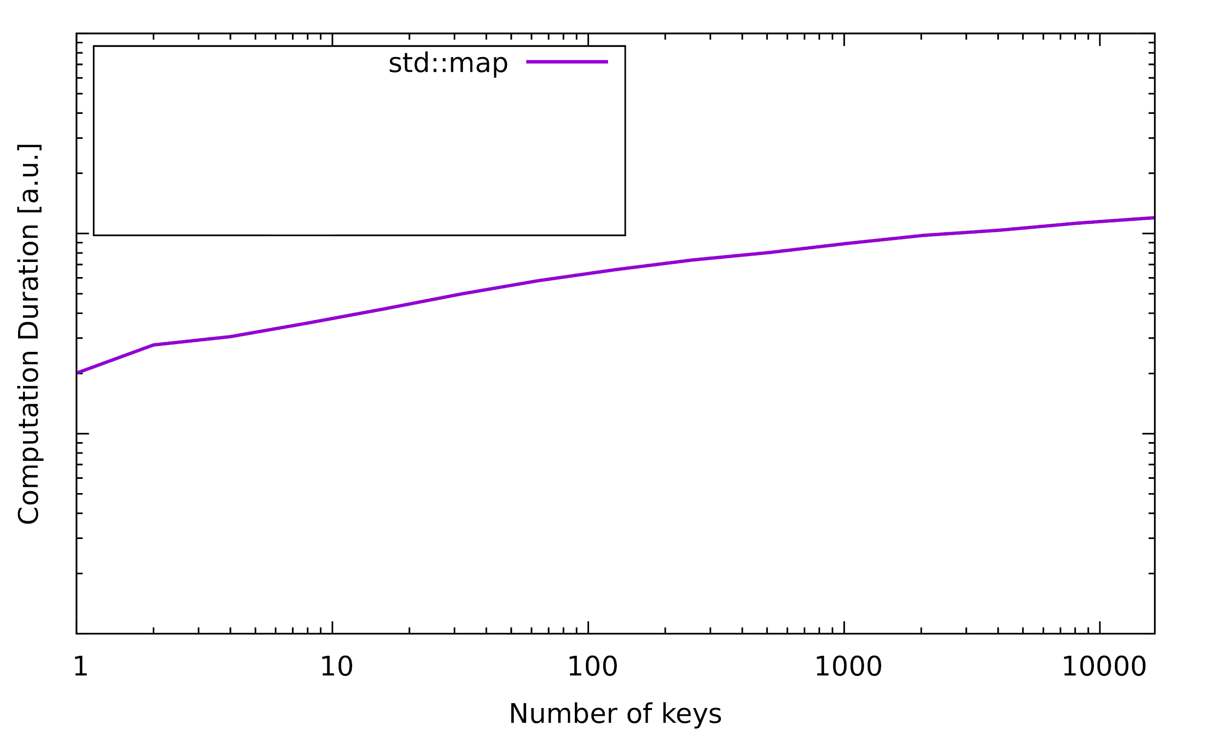
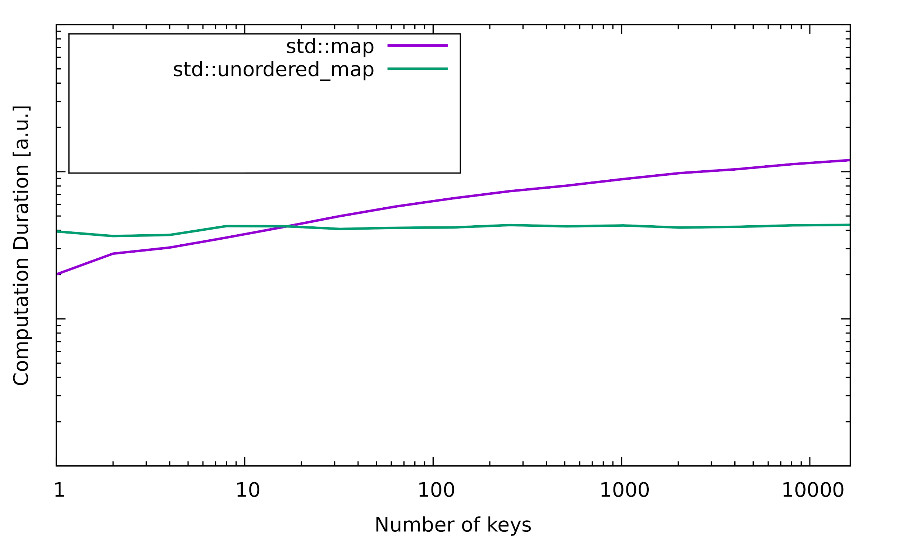
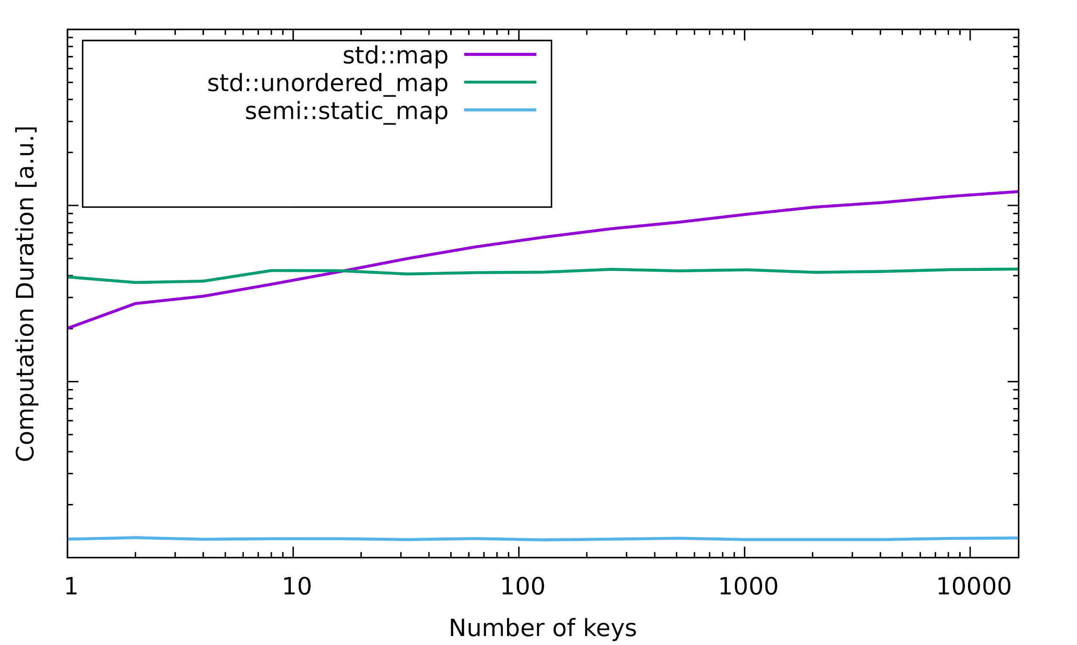
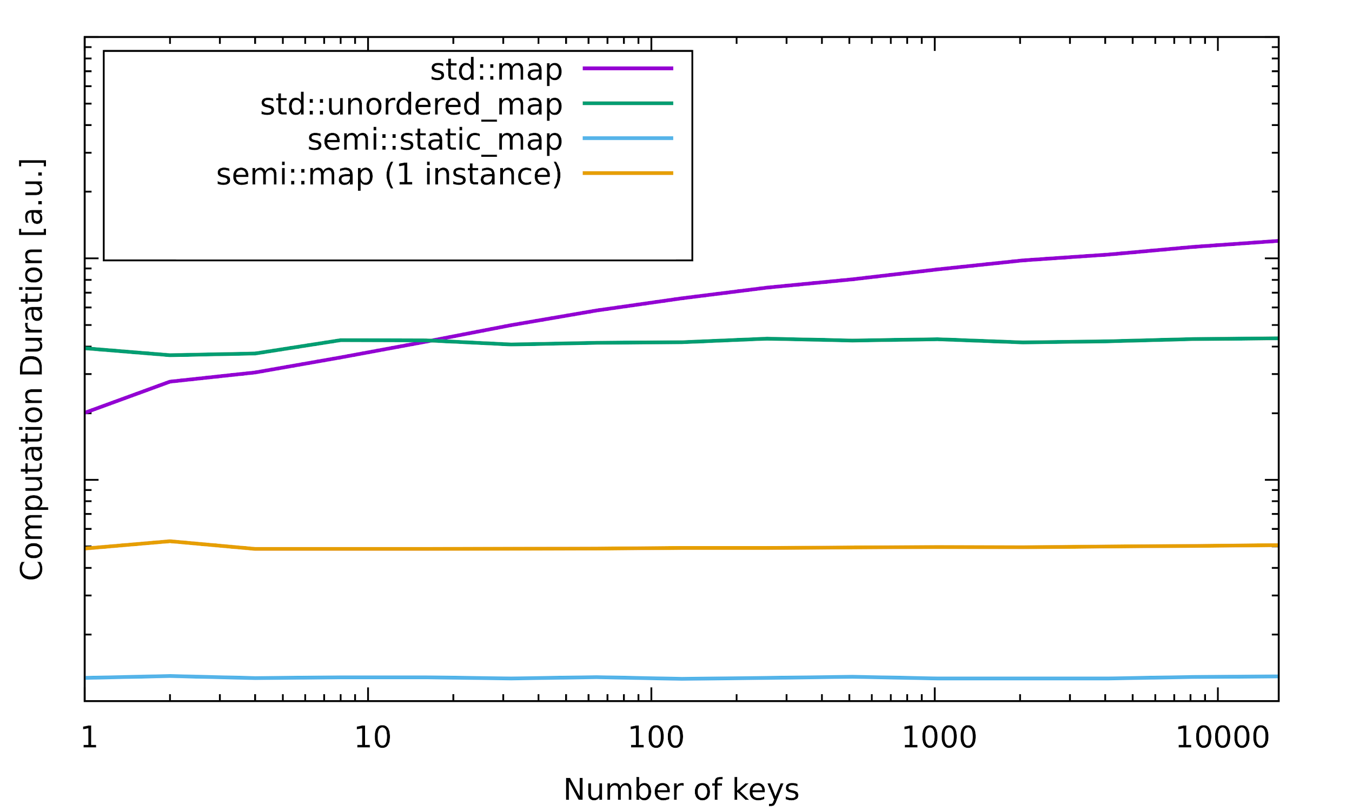
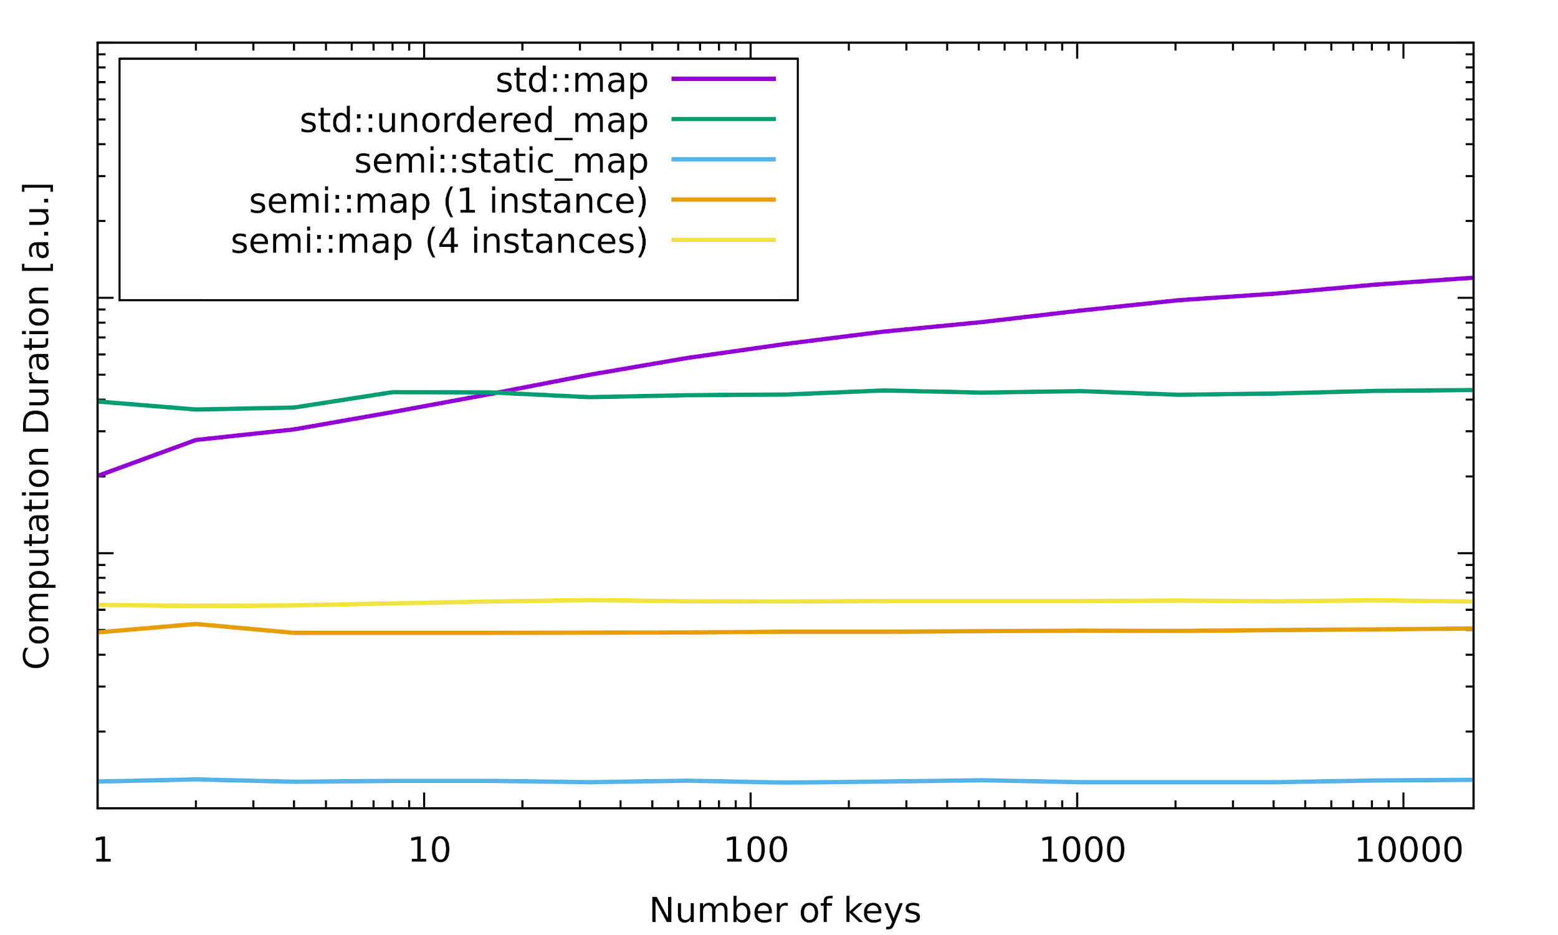
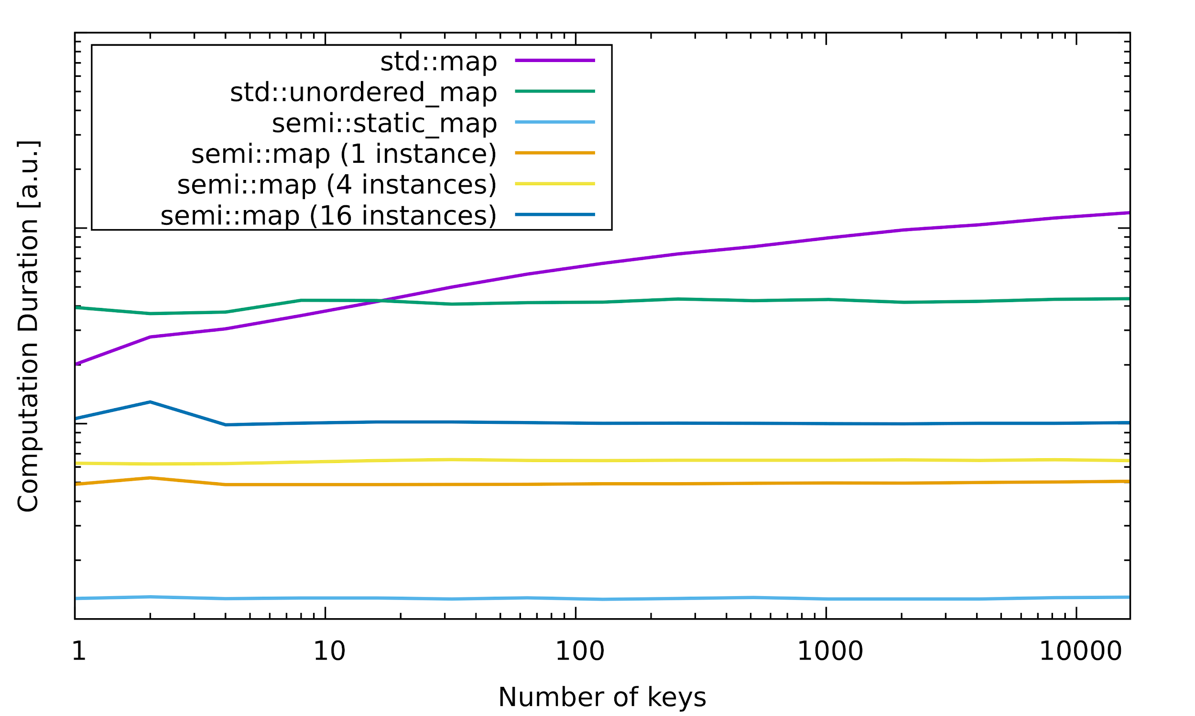
But everything is static?
Benchmarks
Using: clang++ -Ofast -march=native
Notes:
Add that compile-time is very long
Show the big-O of compile-time
Hinted the if(needs_init) with builtin_expect as well

Slide 59
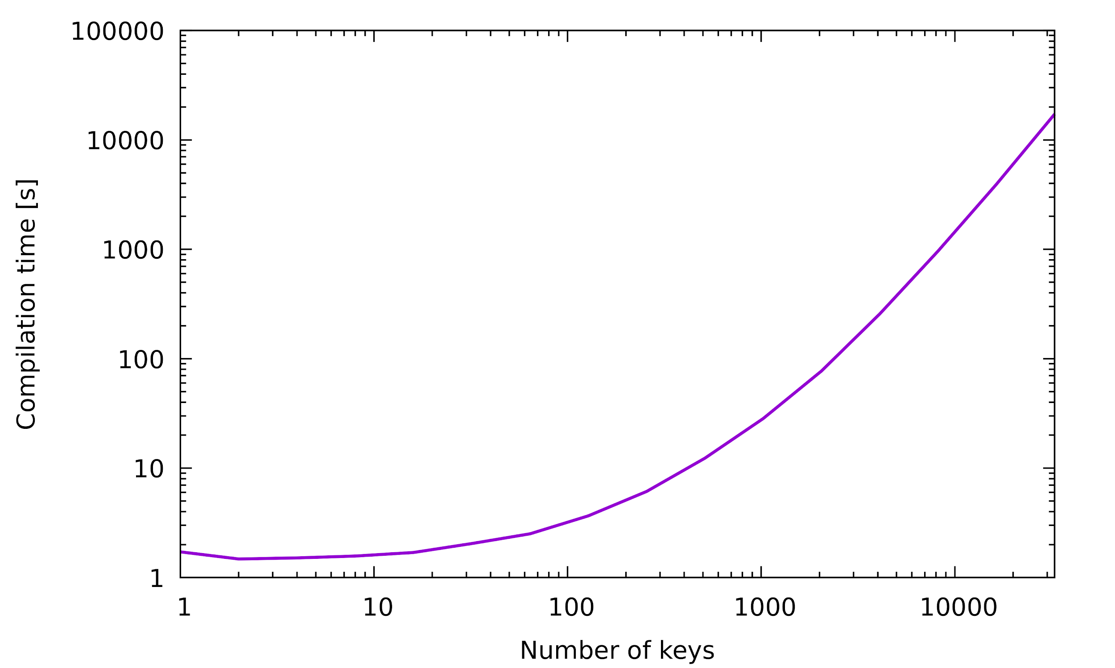
But everything is static?
Benchmarks
Notes:
Add that compile-time is very long
Show the big-O of compile-time
Hinted the if(needs_init) with builtin_expect as well

Slide 60

Thank you!
Code: https://github.com/hogliux/semimap
Video: https://www.youtube.com/watch?v=qNAbGpV1ZkU
@hogliux
fabian.renn@gmail.com
Notes:
Be able to open the code quickly, print-out -

Slide 61
Optional run-time lookup
Only add Value pointer the first time get_internal is called
struct ValueWrapper
{
ValueWrapper (const Key& key) { runtime_map[key] = &v; }
Value v;
};
Faster: Only executed the first time get_internal is called!
template <typename>
static Value& get_internal (const Key& key)
{
static ValueWrapper value(key);
return value.v;
}

Slide 62
Optional run-time lookup
Getting a value from a runtime key is now trivial!
static Value& get(const Key& key)
{
auto it = runtime_map.find(key);
if (it != runtime_map.end())
return it->second;
return runtime_map.emplace_hint(it, key, {new Value, ValueDeleter{nullptr}})->second;
}
Same as before!
Allocate value on heap if not already in runtime_map
We don’t have an init_flat so pass nullptr

Slide 63
Managing key/value life-time
Closer look at the initialise function
void initialise(const Key& key, char* mem, bool& needs_init)
{
auto it = runtime_map.find(key);
if (it == runtime_map.end())
runtime_map.try_emplace(key, new (mem) Value, ValueDeleter{&needs_init});
else
it->second
= std::unique_ptr<Value, ValueDeleter> (new (mem) Value (std::move(it->second)),
ValueDeleter{&needs_init});
}
struct ValueDeleter
{
void operator()(Value* v)
{ if (needs_init != nullptr) { v->~Value(); *needs_init = true;
else { delete v; }
}
bool* needs_init = nullptr;
};

Slide 64
Putting it all together
What’s the performance?
std::string& getName()
{
using map =
semi::static_map<std::string, std::string>;
return map::get(ID("name"));
}
movzx eax, BYTE PTR guard variable
test al, al
je .L15
mov eax, OFFSET FLAT:dummy_tIvalue
ret
.L15:
sub rsp, 8
mov edi, OFFSET FLAT:guard variable
call __cxa_guard_acquire
.
.
.
Only executed the first time value is accessed
Compiler Explorer: https://gcc.godbolt.org/z/Kl8Ynk
Like any static local variable with non-default constructor, the compiler will generate lock guards

